Slide 1
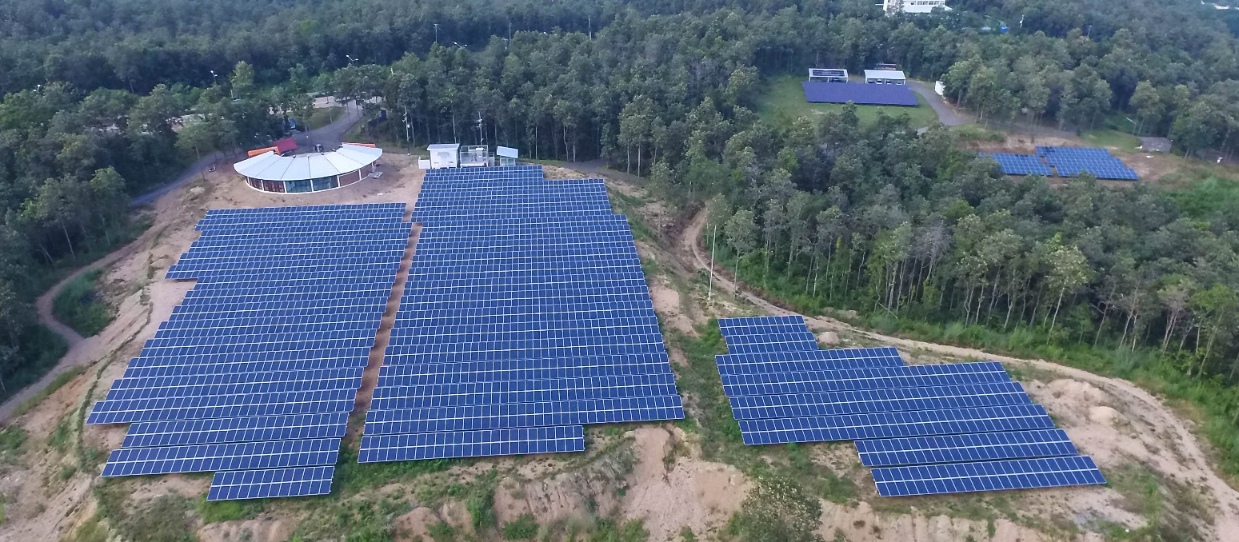
Photovoltaic System
Hathaithip Sintuya

Slide 2
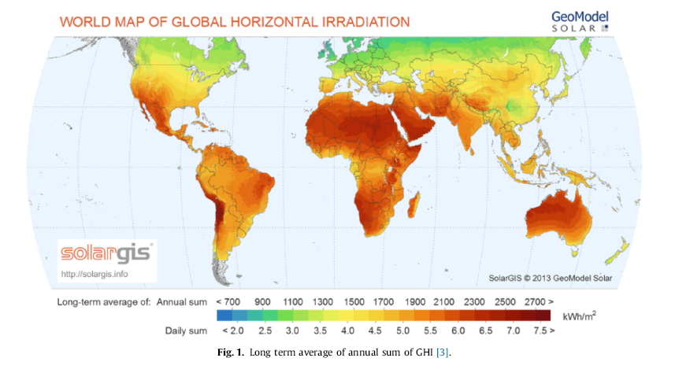
SOLAR RADIATION

Slide 3
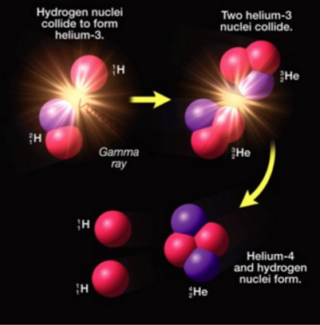
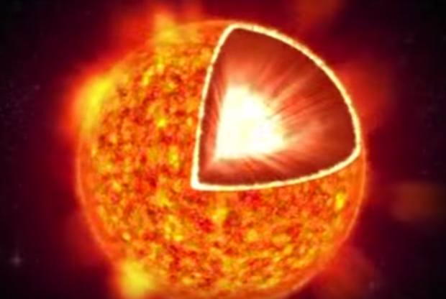
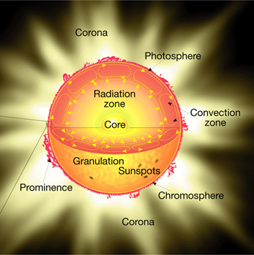
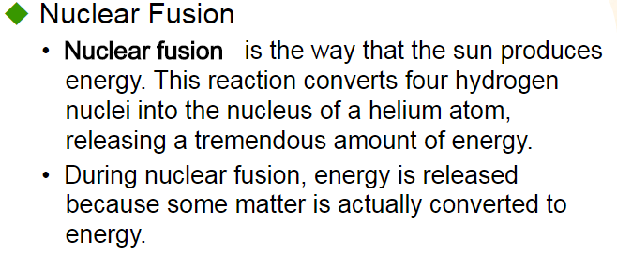
http://slideplayer.com/slide/8754721/

Slide 4
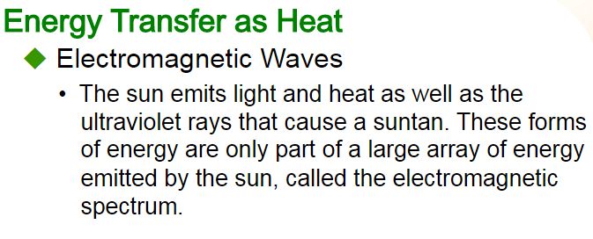
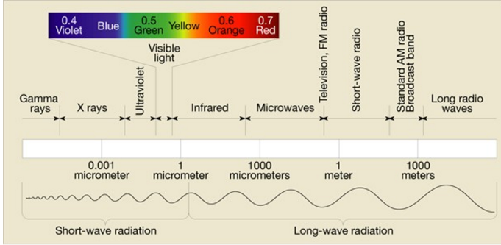
http://slideplayer.com/slide/8754721/

Slide 5
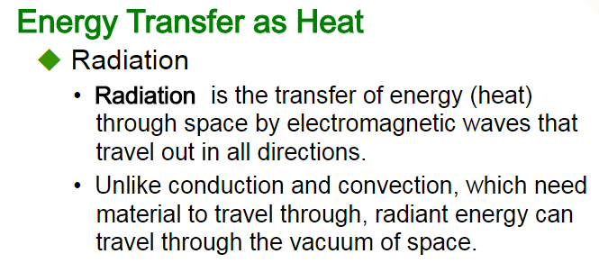
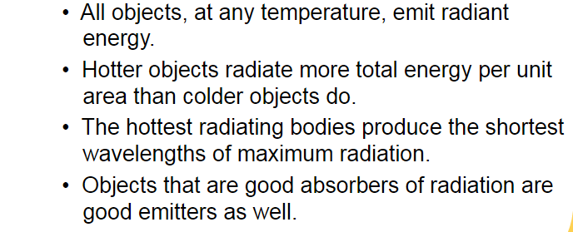

Slide 6
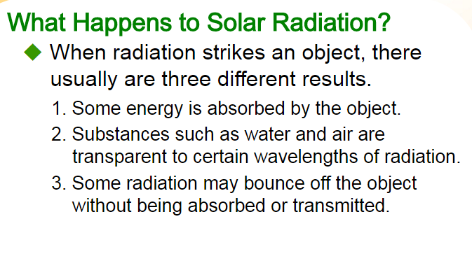

Slide 7
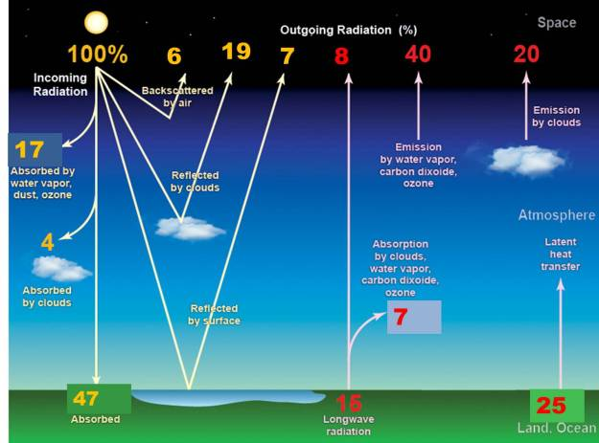
Incoming Solar Radiation
Incoming radiation (short wave radiation)
Incoming solar radiation (insolation) is short wave radiation that comes directly from the sun (100%)
19% is reflected by clouds.
And 6 % is lost to scattering ( radiation diverted by gas molecules)
17% of this is absorbed by the gases in the atmosphere such as carbon dioxide and ozone.
4% of this is absorbed by clouds
7% is reflected by the earth’s surface (called albedo)
So only 47% actually reaches the earth’s surface to be absorbed
https://kisialevelgeography.wordpress.com/as-atmosphere-weather/

Slide 8
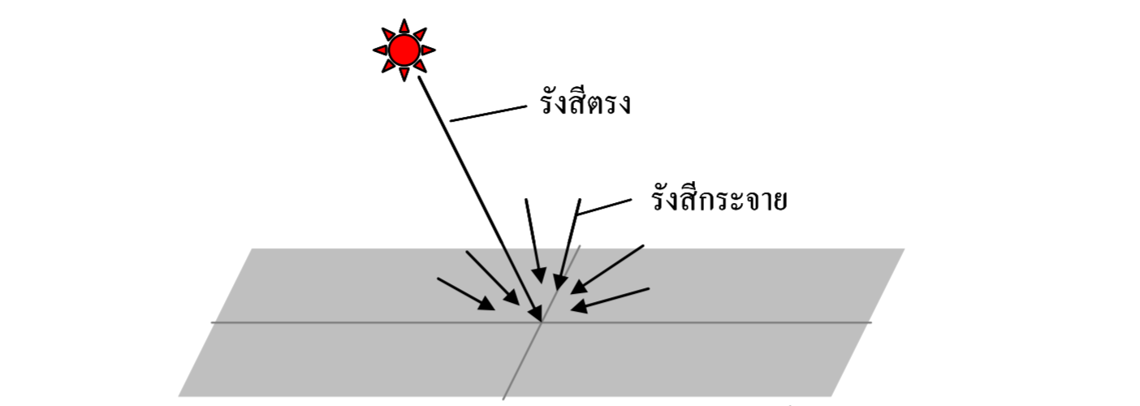
Direct radiation
Diffuse radiation
Direct radiation
Diffuse radiation
Global radiation

Slide 9
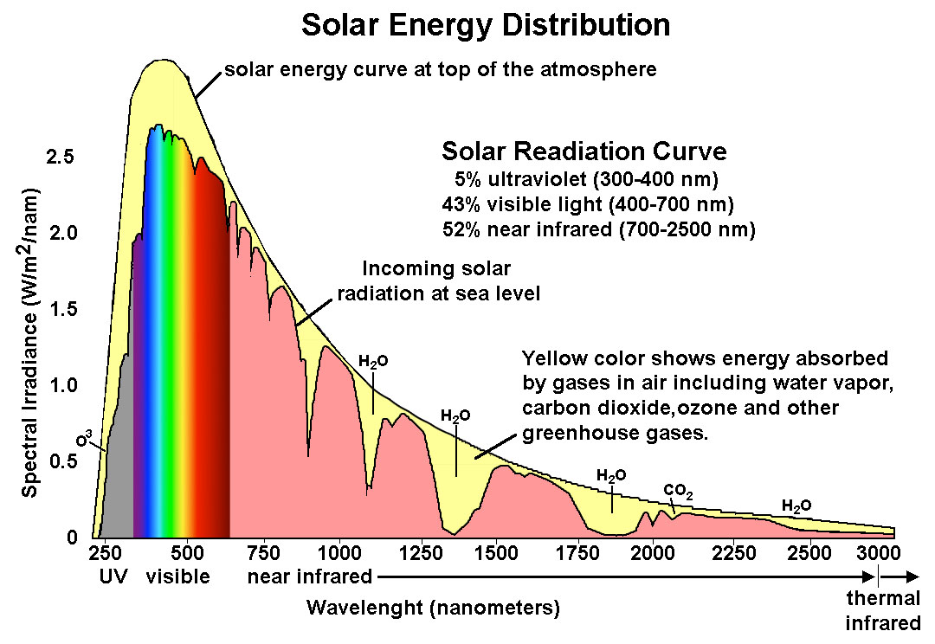
http://geologycafe.com/oceans/chapter8.html

Slide 10
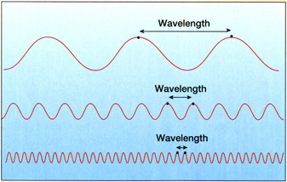

Slide 11
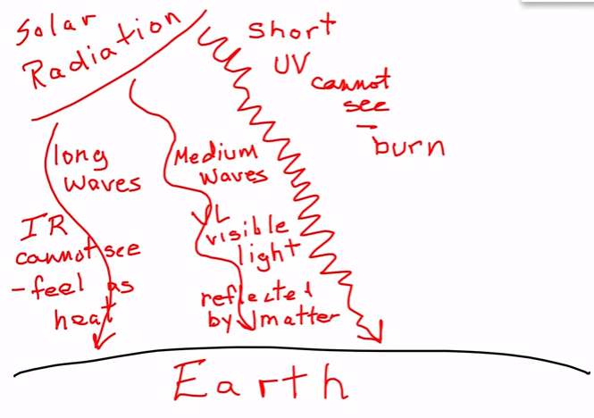
https://www.youtube.com/watch?v=P7CmSW9xF1A

Slide 12
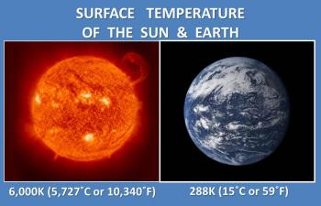
λ max = constant/T
Wien's Law
The wavelength at which maximum radiation is emitted is expressed by the Greek letter “ λ ” (lambda). T is the object's temperature in Kelvin, and the constant is 2,897 μm (micrometers). The higher the object's temperature, the faster the molecules will vibrate and the shorter the wavelength will be.
http://www.ces.fau.edu/nasa/module-2/correlation-between-temperature-and-radiation.php

Slide 13
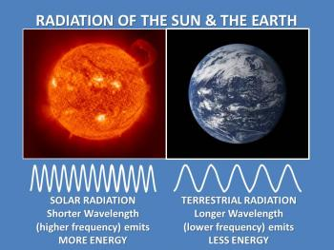
http://www.ces.fau.edu/nasa/module-2/correlation-between-temperature-and-radiation.php

Slide 14
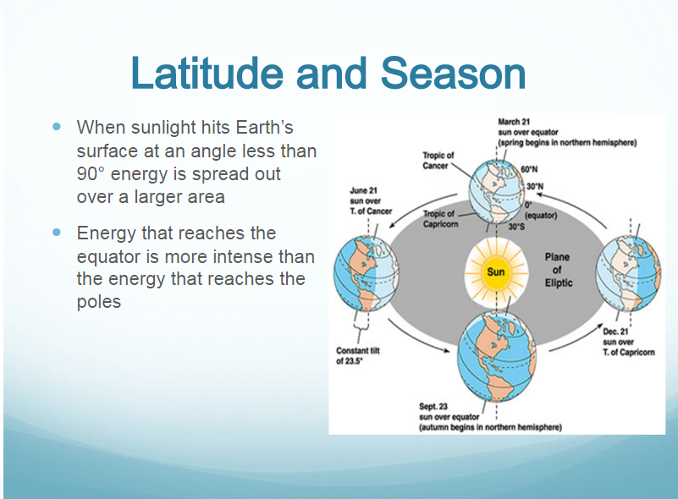
http://slideplayer.com/slide/5780877/

Slide 15
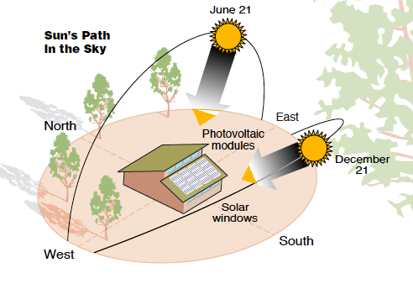
Sun Path
https://greenpassivesolar.com/passive-solar/scientific-principles/movement-of-the-sun/

Slide 16
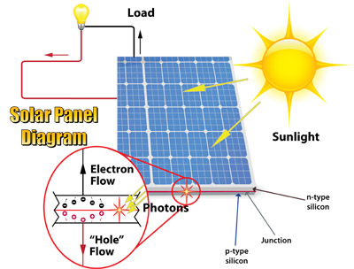
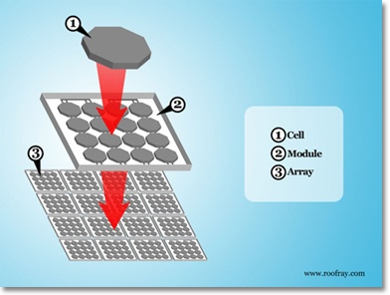
Photovoltaic (PV)
Cell < Module < Panel < Array

Slide 17
Applicable semiconductor materials> Cell Efficiencies
PV technology basics
silicon (Si),
gallium arsenide (GaAs),
cadmium telluride (CdTe),
copper indium diselenide (CIS),
hydrogenated amorphous silicon.
There are significant differences between the best performance and the theoretically predicted value for each material; closing these gaps is the subject of ongoing research (see figure).

Slide 18
Semiconductor

Slide 19
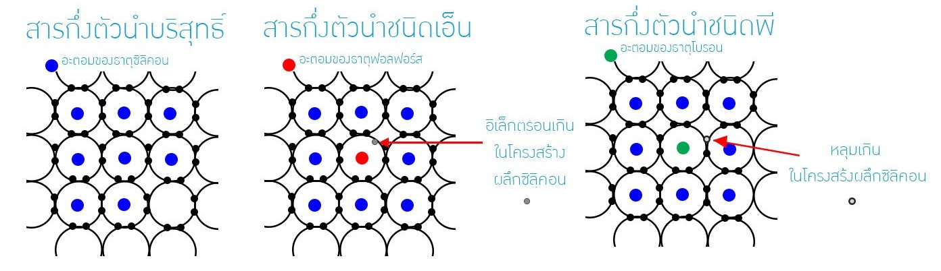
Type of semiconductor
➢ n-type semiconductor
➢ p-type semiconductor
pure silicon
n-type silicon
p-type silicon
http://ienergyguru.com/2015/06/%E0%B8%AA%E0%B8%B2%E0%B8%A3%E0%B8%81%E0%B8%B6%E0%B9%88%E0%B8%87%E0%B8%95%E0%B8%B1%E0%B8%A7%E0%B8%99%E0%B8%B3/

Slide 20
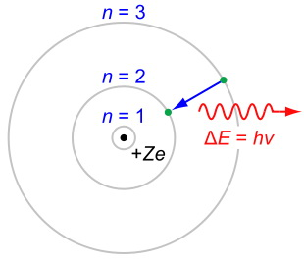
Band Gap of Atom
Conduction band
- higher energy
Valence band
- lower energy
Band gap
Nucleus

Slide 21
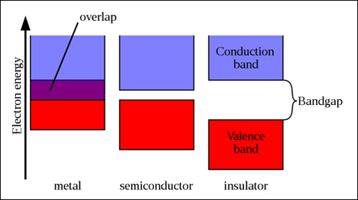
Band Gaps Of Different Materials

Slide 22
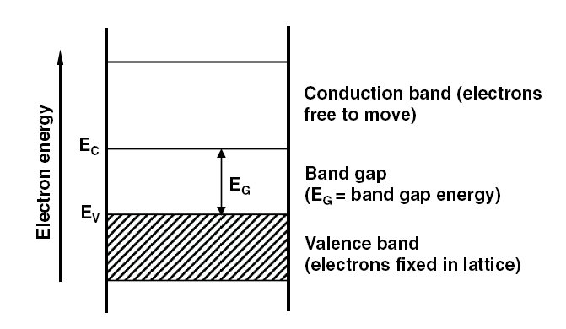
Semiconductor band model

Slide 23
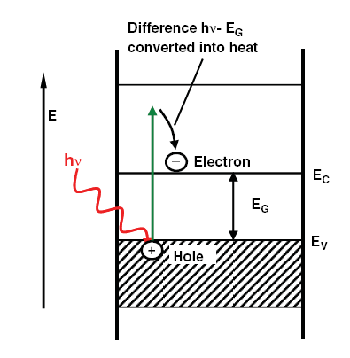
Internal photoelectric effect
Photons where hν>E_{G}
lift an electron out of the valence band into the
conduction band and are absorbed

Slide 24
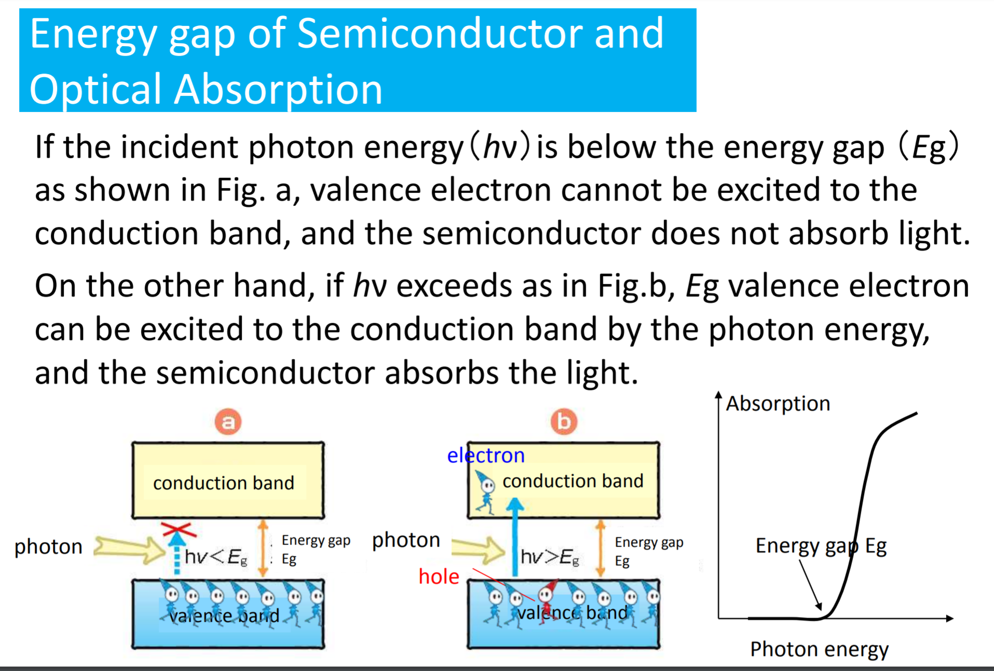

Slide 25
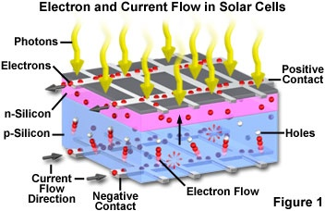
Inside a PV Cell

Slide 26
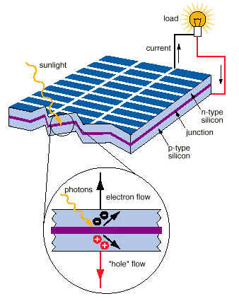
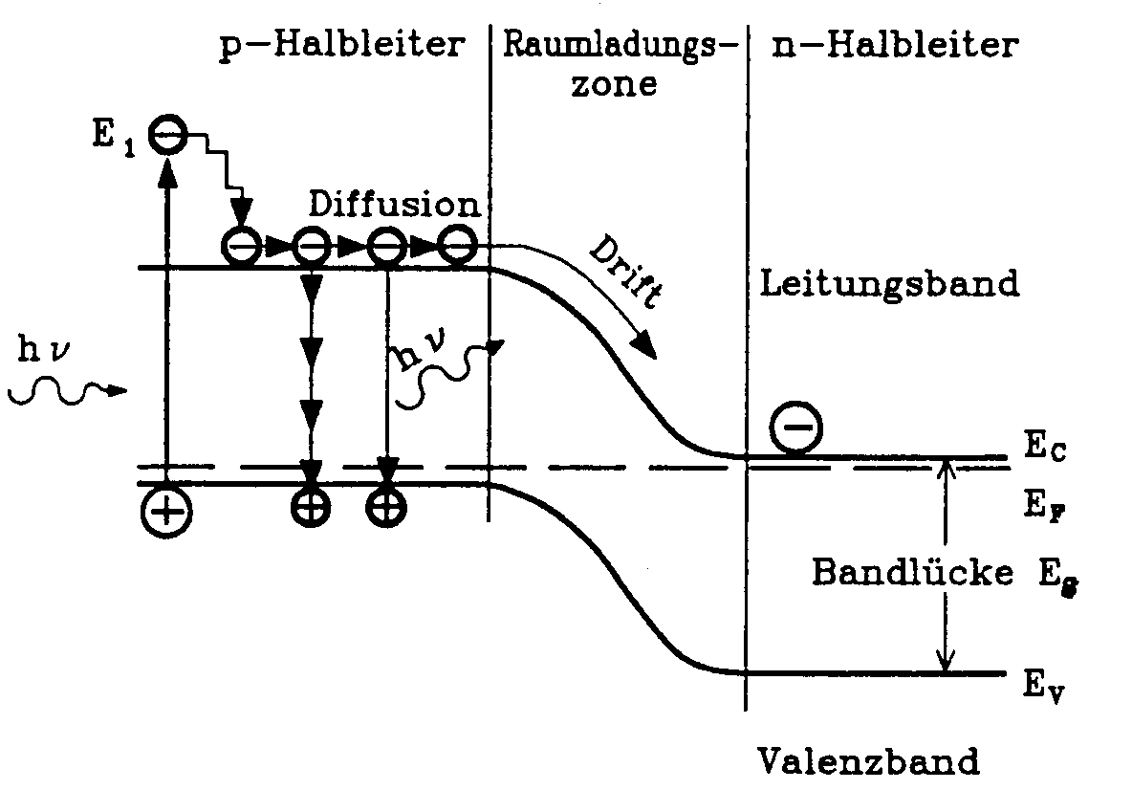
pn-junction under radiation
Absorption of light:
If Eph < Eg → no electron-hole-creation
If Eph > Eg → electron-hole-creation → drift
and diffusion → current and voltage
Band structure
Solar cell under radiation
Notes:
Electron-hole creation,
In the space charge region →the electric field seperates the carriers. Electron goes to the n-region. → n region becomes more and more negativ. → electric field → the diffusion potential decreases
Outside of the space charge region: can get into the region by diffusion because of the thermal energy. But depends on the diffusion length of the electron in the special material
It depends strongly on the recombination processes how many carriers get to the particular side.
The potential barrier prevents that each carrier can go to the wrong side.
At some time the created potential prevents more electrons to get to the negative region. That is when the created electrical potential equals the diffusion potential of the pn junction → open circuit voltage

Slide 27
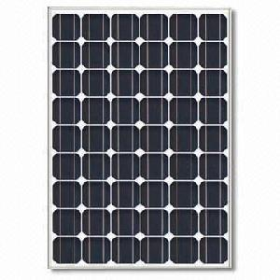
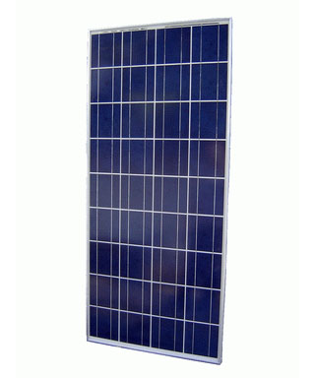
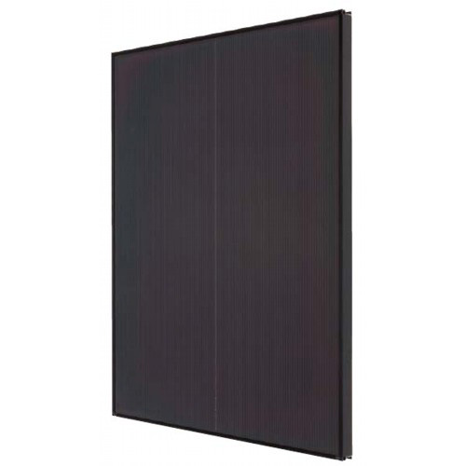
Available Cell Technologies
Single-crystalline
or
Mono-crystalline Silicon
Polycrystalline
or
Multi-crystalline
Thin film
  Ex. Amorphous silicon or Cadmium Telluride

Slide 28
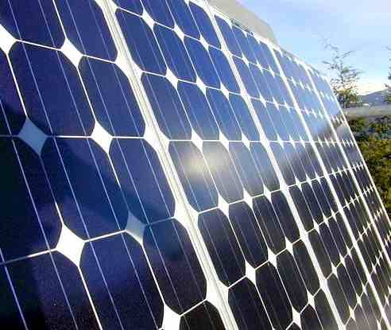
Monocrystalline Silicon Modules
Most efficient commercially available module (11% - 14%)
Most expensive to produce
Circular (square-round) cell creates wasted space on module

Slide 29
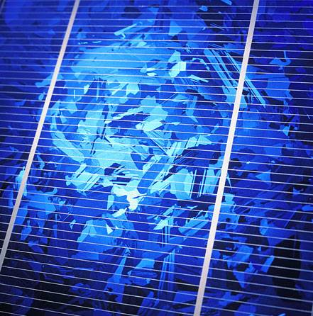
Polycrystalline Silicon Modules
Less expensive to make than single crystalline modules
Cells slightly less efficient than a single crystalline (10% - 12%)
Square shape cells fit into module efficiently using the entire space

Slide 30
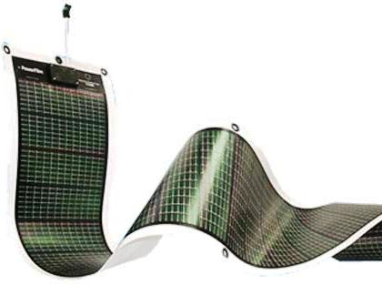
Amorphous Thin Film
Most inexpensive technology to produce
Metal grid replaced with transparent oxides
Efficiency = 6 – 8 %
Can be deposited on flexible substrates
Less susceptible to shading problems
Better performance in low light conditions that with crystalline modules

Slide 31
Selecting the Correct Module
Practical Criteria
  Size
  Voltage
  Availability
  Warranty
  Mounting Characteristics
  Cost (per watt)

Slide 32
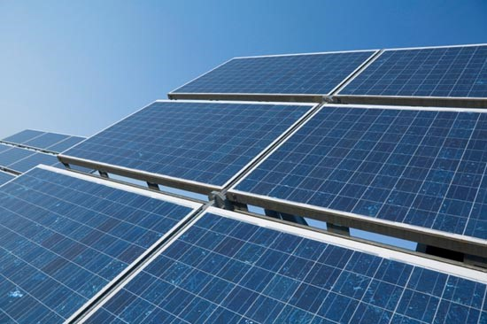
Silicon-based solar cells
http://eeeug.com/industries)

Slide 33
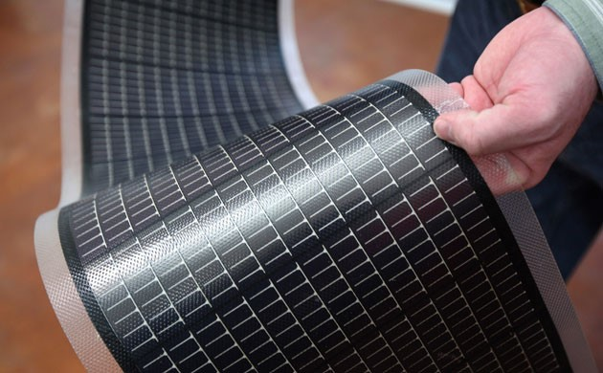
Thin film solar cells
http://www.mysolargenerator.info

Slide 34
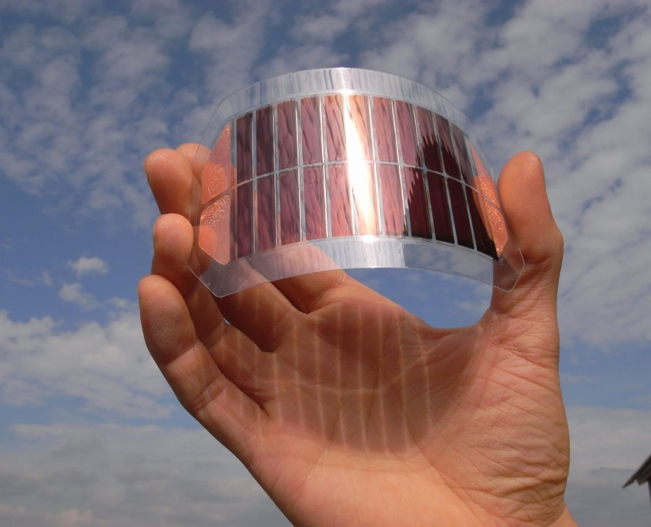
Organic solar cells
http://www.exposolar.org

Slide 35
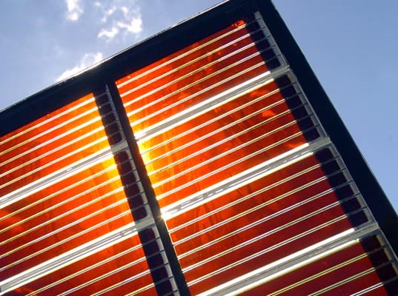
Dye-sensitized solar cells
assets.inhabitat.com

Slide 36
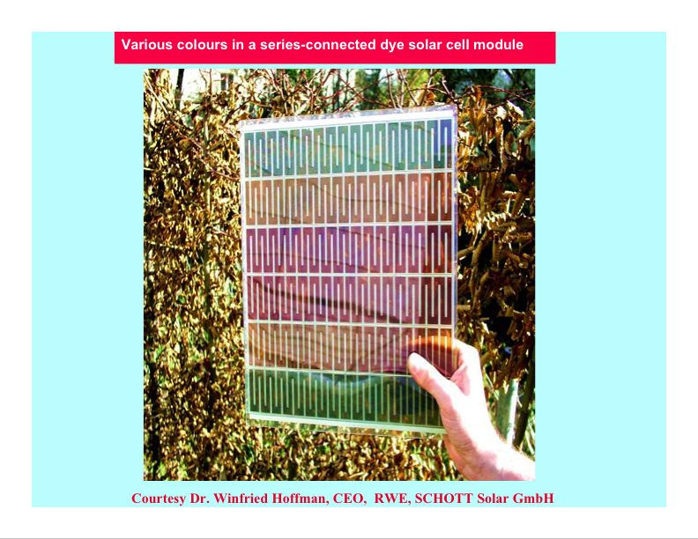

Slide 37
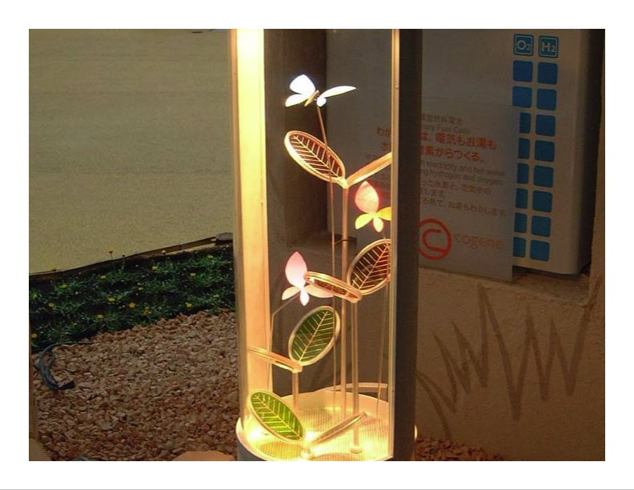

Slide 38
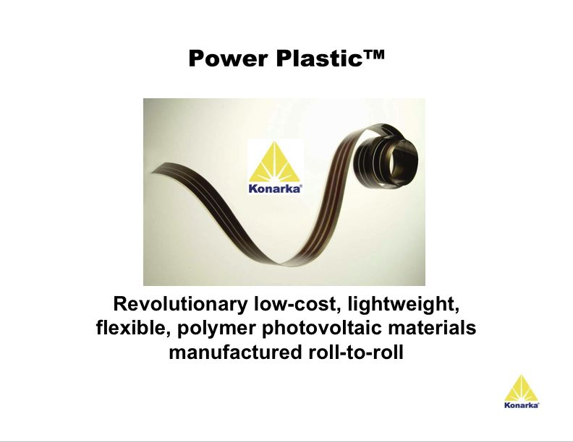
KONARKA

Slide 39
PV Performance

Slide 40
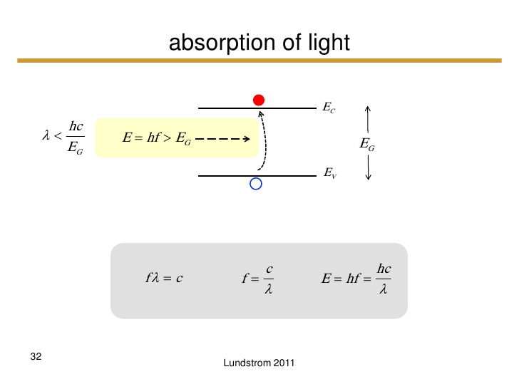
http://www.slideshare.net/Jupiter276/20110720-ncnsc01lundstrom

Slide 41
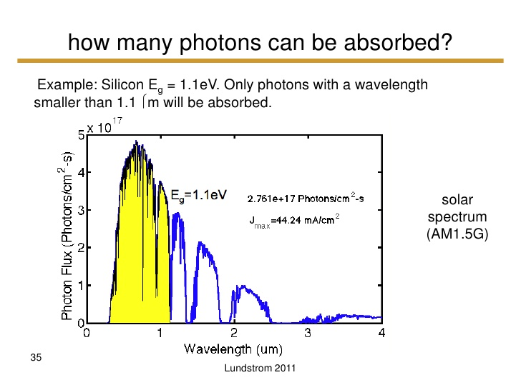
http://www.slideshare.net/Jupiter276/20110720-ncnsc01lundstrom

Slide 42
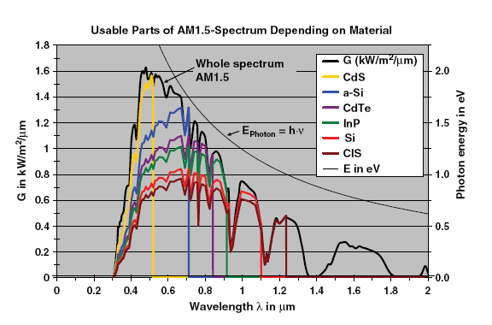

Slide 43
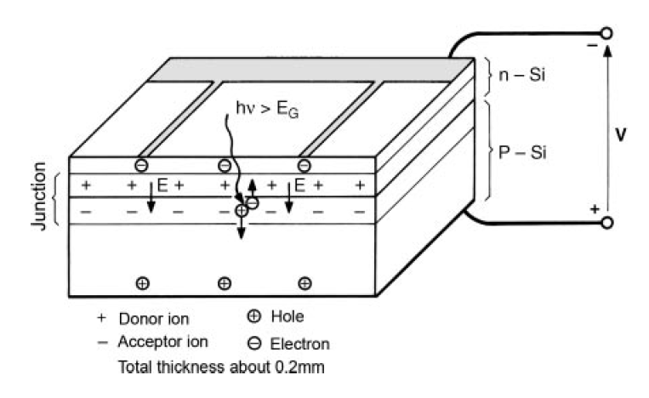
Basic structure of a crystalline silicon solar cell

Slide 44
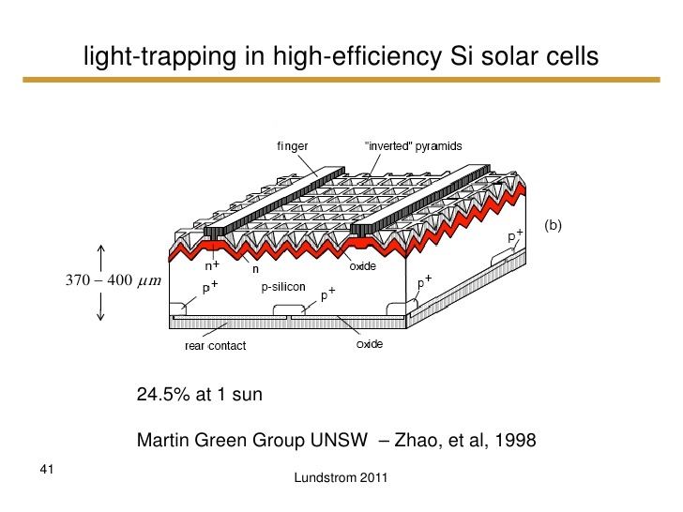

Slide 45
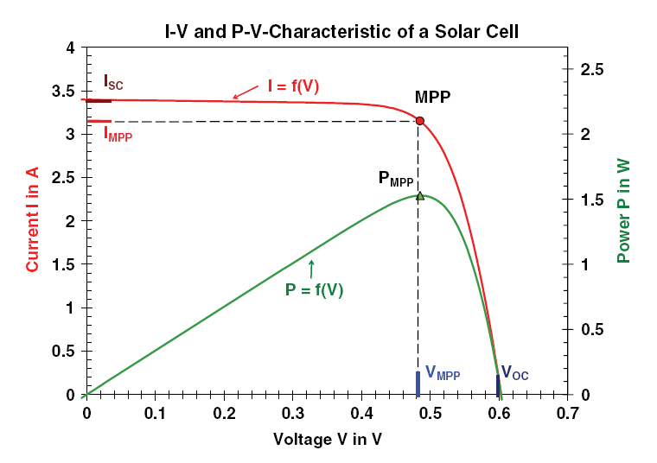
MPP
maximum power point
V_{OC}
open-circuit voltage
I_{SC}
short-circuit current
Characteristic curves I = f(V) and P = f(V) of a monocrystalline silicon solar cell with a cell area of approximately 102 cm², irradiance G amounting to 1 kW/m² and 25 ºC cell temperature

Slide 46

Maximum Cell Performance

Slide 47

Fill factor (FF): the ratio
of Pmax to VOC ISC is a key solar cell measurement value, along with efficiency.
The fill factor for commercially available solar cells ranges from around 60 to 80%, while this factor for
lab cells can go as high as about 85%.

Slide 48


Slide 49


Slide 50

Effects of Temperature
As the PV cell temperature increases above 25º C, the module V_{mp} decreases by approximately 0.5% per degree C
Notes:
Leave 6” space between roof and panel

Slide 51

Effects of Shading/Low Insolation
As insolation decreases amperage decreases while voltage remains roughly constant
Notes:
Insolation is a measure of solar radiation energy received on a given surface area in a given time.

Slide 52

Shading on Modules
Depends on orientation of internal module circuitry relative to the orientation of the shading.
SHADING can half
or even completely
eliminate the output
of a solar array!

Slide 53
Three Types of Systems
Stand-alone systems - those systems which use photovoltaics technology only, and are not connected to a utility grid.
Hybrid systems - those systems which use photovoltaics and some other form of energy, such as diesel generation or wind.
Grid-tied systems - those systems which are connected to a utility grid.
Notes:
There are basically three types of photovoltaic systems. The stand alone systems use photovoltaics technology only, and are not connected to a utility grid. The usually have some form of backup. The second type of system is the hybrid system. Hybrid systems are made up of PV and some other forms of energy production, such as wind or diesel generation. Finally, grid-tied systems do not necessarily need backup at all and are tied directly to the utility grid. The grid stores the energy. For example, if you have a PV system on your house, and it produces more energy than needed, the extra will go back onto the grid. So during cloudy days or at night, you can pull the energy from the grid into your home.
Source:
http://www.sandia.gov/pv/docs/Design_and_Installation_of_PV_Systems.htm

Slide 54


Stand Alone PV System
Water pumping
Notes:
This is an example of a stand alone PV system. To pump water in India as shown here, you have the PV arrays which produce electricity, which travels through a disconnect switch and linear current booster to provide power to the water pump. This system is common in underdeveloped countries and agricultural applications. It is very simple to design and has no storage.
Sources:
http://www.sandia.gov/pv/docs/WPSize.html
http://www.nrel.gov/data/pix/searchpix.cgi?getrec=9085241&display_type=verbose&search_reverse=1

Slide 55


Examples of Stand Alone
PV Systems
PV panel on a water pump in Thailand
PV powers stock water pumps in remote locations in Wyoming
Notes:
Here are some examples of stand alone PV systems. The bottom picture is a water pump that is providing water for cows in Wyoming. It actually will fill up a reservoir of water and only keep providing electricity to the pump when it is necessary. You can also see there is a tracking system so that it tracks the sun as it follows it’s arc in the sky and allows more sunlight to be collected.The University of Wyoming and several rural electric companies have set up rural demonstration projects to study the durability, maintenance requirements, and useful life of solar-powered water-pumping systems. Because of the vast, rural spaces in Wyoming, PV is a feasible solution to power needs in remote areas where traditional utility infrastructure is not economically viable. A medium-size solar-powered system costs about $12,000. The depth of the well and the amount of water needed on a case-by-case basis determine the size of the system.
The other picture is a water pump that provides water for a farm in Thailand.
Sources:
http://www.nrel.gov/data/pix/searchpix.cgi?getrec=3203790&display_type=verbose&search_reverse=1
http://www.nrel.gov/data/pix/searchpix.cgi?getrec=714300&display_type=verbose&search_reverse=1Title:

Slide 56

Examples of Stand Alone
PV Systems
Communications facilities can be powered by solar technologies, even in remote, rugged terrain. Also, if a natural or human-caused disaster disables the utility grid, solar technologies can maintain power to critical operations
Notes:
Here are some examples of stand alone PV systems. Communications facilities can be powered by solar technologies, even in remote, rugged terrain. Also, if a natural or human-caused disaster disables the utility grid, solar technologies can maintain power to critical operations. It is very common to see these used for communication stations.
Sources:
http://www.nrel.gov/data/pix/Jpegs/11040.jpg
http://www.nrel.gov/data/pix/searchpix.cgi?getrec=2737546&display_type=verbose&search_reverse=1

Slide 57

Examples of Stand Alone
PV Systems
This exhibit, dubbed "Solar Independence", is a 4-kW system used for mobile emergency power.
while the workhorse batteries that can store up to 51 kW-hrs of electricity are housed in a portable trailer behind the flag.
The system is the largest mobile power unit ever built
Notes:
Here is another example of a stand alone system. This exhibit, dubbed "Solar Independence", is a 4-kW system. It can provide power for one or two homes. It can store up to 51 kW-hrs of electricity that is stored in the portable trailer to the right of the flag. It is made to look like a flag to encourage American patriotism. This is one of the largest mobile power units ever built. It can be used for demonstrations at schools.
The flag's field of blue consists of PV panels that generate enough electricity to power 1-2 homes. Red and white stripes make it look like the flag. The system was designed by NREL's Ben Kroposki and set up by a host of volunteers from the National Center for Photovoltaics and the Public Affairs Office
Sources:
http://www.nrel.gov/data/pix/Jpegs/09654.jpg
http://www.nrel.gov/data/pix/searchpix.cgi?getrec=3857226&display_type=verbose&search_reverse=1

Slide 58


Examples of Stand Alone
PV Systems
Smiling child stands in front of Tibetan home that uses 20 W PV panel for electricity
PV panel on rooftop of rural residence
Notes:
This is an example of very small PV systems to provide electricity for indoor lighting in rural residence in Tibet. In America we tend to forget that there are still many places around the world that cannot get electricity easily. These PV systems help rural families like this get some electricity for lighting and refrigeration.
Sources:
http://www.nrel.gov/data/pix/Jpegs/02124.jpg
http://www.nrel.gov/data/pix/searchpix.cgi?getrec=8899172&display_type=verbose&search_reverse=1
http://www.nrel.gov/data/pix/Jpegs/01540.jpg
http://www.nrel.gov/data/pix/searchpix.cgi?getrec=9195758&display_type=verbose&search_reverse=1

Slide 59

Hybrid PV System
Notes:
This is a block diagram of a hybrid PV system. The PV array produces electricity, which goes through the blocking diode and the fused disconnect to get to the maximum power tracker. If you need electricity immediately, it runs though the inverter and transformer and goes to your load. Otherwise, it is stored in a battery. Then if it became dark out, you can draw the energy from the battery. If it is dark for a very long time, you can draw the energy from the diesel generator.
Source:
http://www.sandia.gov/pv/docs/BOS.htm

Slide 60

Examples of Hybrid
PV Systems
Ranching the Sun project in Hawaii generates 175 kW of PVpower and 50 kW of wind power from the five Bergey 10 kW wind turbines
Notes:
This example of a hybrid system is a ranch project in Hawaii where you have both wind and solar PV energy needed for the farm. There is 175 kW of PV power and 50 kW of wind power.
Sources:
http://www.nrel.gov/data/pix/Jpegs/13822.jpghttp://www.nrel.gov/data/pix/searchpix.cgi?getrec=491123&display_type=verbose&search_reverse=1

Slide 61

Examples of Hybrid
PV Systems
A fleet of small turbines; PV panels in the foreground
Notes:
Here is another example of a wind/PV hybrid project. The fleet of small turbines capture power for the New Life Evangelistic Center in New Bloomfield, Missouri.
Sources:
http://www.nrel.gov/data/pix/searchpix.cgi?getrec=510501&display_type=verbose&search_reverse=1

Slide 62

Examples of Hybrid
PV Systems
PV / diesel hybrid power system - 12 kW PV array, 20 kW diesel genset
This system serves as the master site for the "top gun" Tactical Air Combat Training System (TACTS) on the U.S. Navy's Fallon Range.
Notes:
This is an example of a PV/ diesel hybrid project. There is 12 kW PV array and 20 kW diesel generator housed behind it. This system serves as the master site for the “top gun” training for the U.S. Navy.
Sources:
http://www.nrel.gov/data/pix/Jpegs/08961.jpg
http://www.nrel.gov/data/pix/searchpix.cgi?getrec=4453216&display_type=verbose&search_reverse=1

Slide 63

Grid-Tied PV System
Notes:
Most of us are interested in grid-tied systems because most of us are connected on grid system houses, so if you don’t have a ranch or a cottage up in the country, you get your electricity from a grid. For this type of system it is very feasible to put a solar array on your roof. Here you have solar panel array on your roof, sun shines on it and produces a DC voltage (like a battery). Then it runs through the inverter and turns into AC Voltage (like the electricity that comes from a wall outlet). The inverter is usually monitored in some way. Usually you’ll have a panel inside your home. AC voltage goes straight to the main utility breaker panel. From there it can be used to power any electrical device in your home. In cases, lets say, at lunch time, if you’re at work, and the solar cell is doing really good because it’s a sunny day out, you’re going to be producing a lot of electricity, and then it can be fed back into grid and spin your utility meter backwards. You then only pay for the net amount of electricity you use. This is called net metering. You are only paying for the net amount of electricity you are consuming. Some solar users purposely make more electricity than they use so they can receive money back from the electric companies.
Base definitions for grid tied solar photovoltaic systems:
Solar Panels convert sunlight directly into electricity. The Inverter converts the solar electricity (DC) into household current (AC) that can be used to power loads in the house. The System Monitor is an easy-to-read digital meter that shows the homeowner the amount of electricity generated both cumulatively and daily. The Utility Meter tracks power usage and production, spinning forward when electricity is used from the grid, and spinning backwards, generating a credit, when the solar system creates more electricity than is used in the house.
Sources:
http://www.solarmarket.com/frontier.html

Slide 64

Examples of Grid Tied Systems
National Center for Appropriate Technology Headquarters
Notes:
This is the National Center for Appropriate Technology Headquarters. As you can see it is solar designed and has solar panels on the roof. Solar power fills some of the power needs at the headquarters in Butte, Montana. The photovoltaic system was installed on NCAT's roof by Solar Plexus of Missoula; it consists of 60 Shell SP75 modules. Each module is rated at 75 watts and is flush-mounted on the south-facing, third-floor roof; total module area is about 480 ft². Peak electrical output of the system is 4.5 kilowatts. Thirty modules make up each of the east and west arrays. Each array is electrically connected to produce direct current (DC) at 48 volts. The output from each array can be disconnected for comparison purposes. The system's DC electrical output is connected to a Trace SW4048UPV utility intertie inverter. The inverter, connected to the utility grid, senses the utility's voltage and frequency and produces alternating electricity at the utility's voltage and frequency. The inverter is designed to operate only when utility electricity is available. Whenever the utility goes down, the inverter shuts down and will only turn back on when the utility line comes back on. This is for safety and now all modern inverters have this feature. The system provides about 15% of the NCAT building's electrical consumption.
Sources:
http://www.nrel.gov/data/pix/searchpix.cgi?getrec=4160053&display_type=verbose&search_reverse=1

Slide 65

Examples of Grid Tied Systems
The world's largest residential PV project
Notes:
This is the world’s largest residential PV project. It has PV for every single apartment. The system produces over 180 kWp in this 500 home development -- 2.7 kW systems on 32 pitched roofed houses and 3.06 kW systems on 32 flat roofed houses in Amersfoort, Netherlands.
Sources:
http://www.nrel.gov/data/pix/searchpix.cgi?getrec=4555856&display_type=verbose&search_reverse=1

Slide 66


Slide 67
End

